Slide 1
Disruptive
Transcoding

Slide 2
Transcoding is mission critical

Slide 3
Quality

Slide 4
Quality of Experience

Slide 5
Buffering…

Slide 6
Total Costs of Ownership
Transcoding
Bandwidth
Storage
Operations

Slide 7
Cloud, or On-Prem?

Slide 8
MaelStrom
Disruptive transcoding

Slide 9
Disruptive
Hardware
Hybrid software and NETINT ASICS

Slide 10
Quality
CPU
GPU
ASICS

Slide 11
One frame latency

Slide 12
1-Frame latency

Slide 13
Green: 89% less energy
Software transcoding, 80 channels
2800 w
Hardware transcoding, 80 channels
308 w

Slide 14
Disruptive cost reduction
Generic cloud transcoding costs, per channel, per month
€ 2000 - € 7500
Jet-Stream Cloud
€ 750

Slide 15
Transcoding cost savings
€ 6,000,000
80 FHD channels, 5 years operation

Slide 16
Energy cost savings
€ 22,000
80 FHD channels, 5 years operation

Slide 17
Operational savings
€ 48,000
80 FHD channels, 5 years operation

Slide 18
Disruptive
Automation

Slide 19
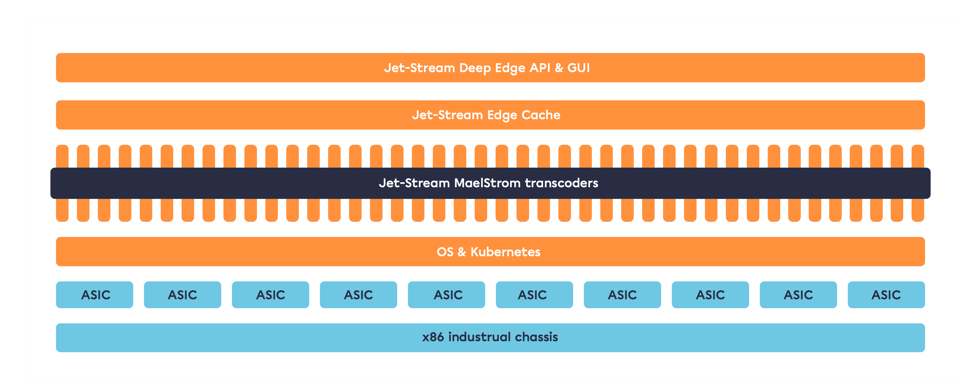
Modern, hybrid architecture

Slide 20
Automatic scaling, pooling, recovery
Kubernetes high availability clustering

Slide 21
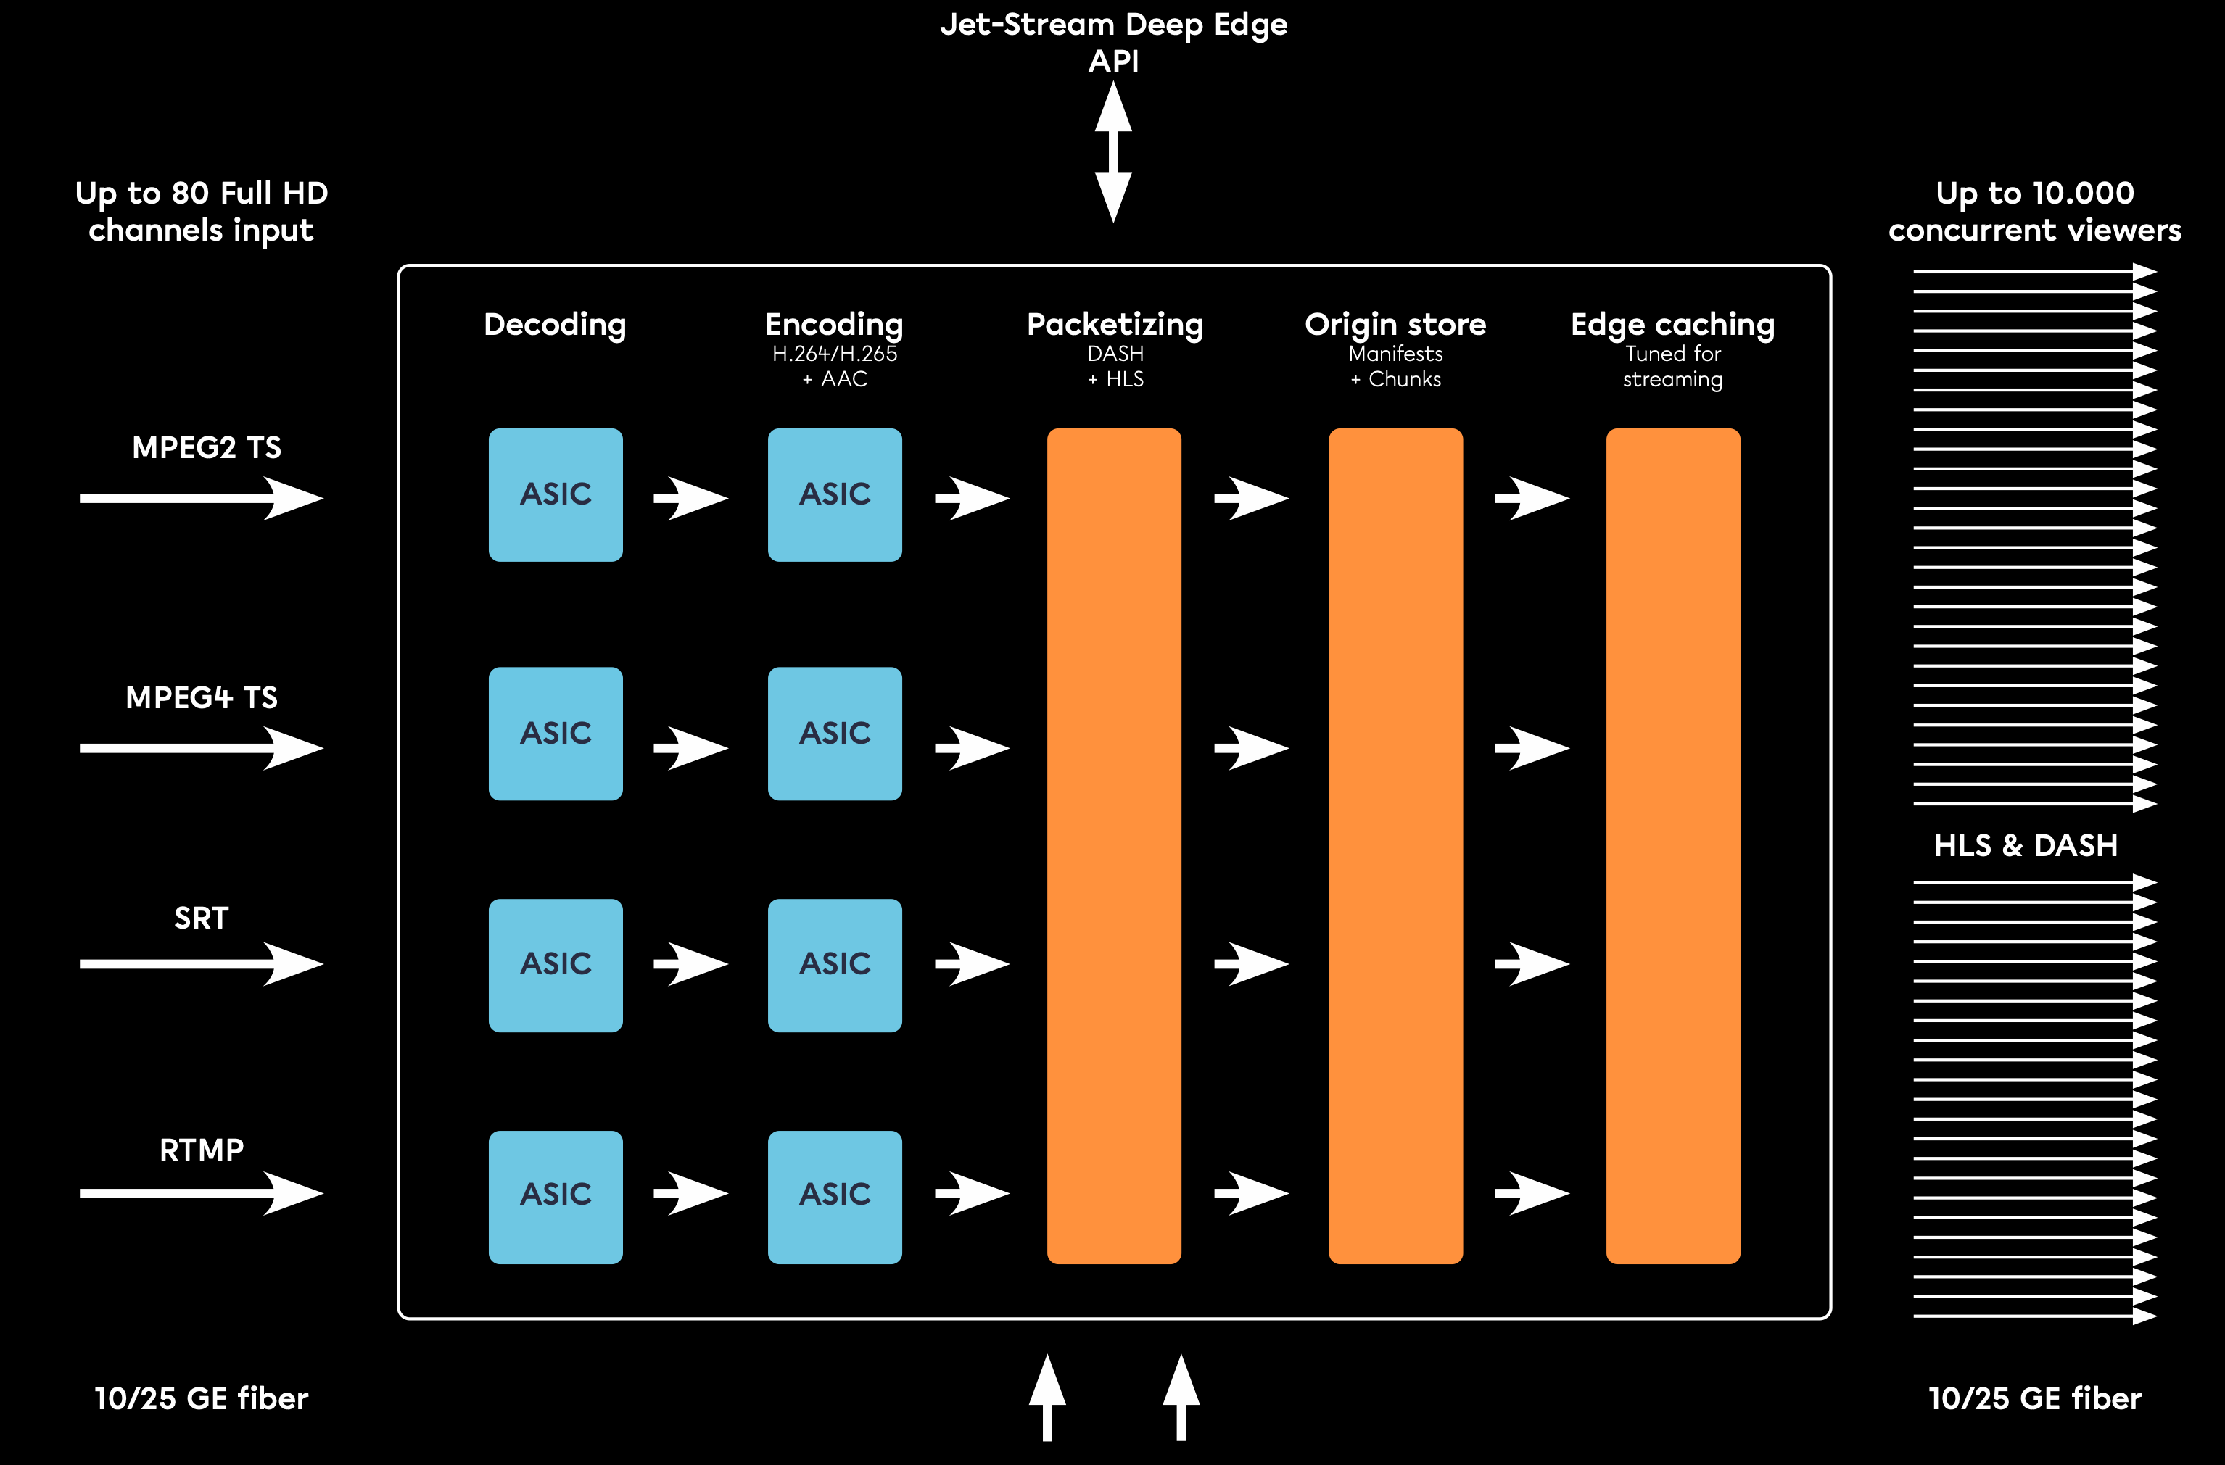

Slide 22
Scaling, per 32amp rack
CPU encoding
200 channels
Hardware accelerated
2400 channels

Slide 23
Disruptive
Interfaces

Slide 24
Clouds
Complex, expensive, but full control

Slide 25
This is you ->

Slide 26
Video platforms
Easier, but limited control

Slide 27
Easier
than
video platforms.
Fly first class.

Slide 28
OnAir: One click 4K live streaming
Cloud encoder, transcoder, multi-CDN, player & statistics.

Slide 29
One click encoder setup
For RTMP, RTSP and SRT encoders

Slide 30
Smarter than
cloud media services.
Be the pilot.

Slide 31
Video filters
Deinterlacing, logo burns, HDR - SDR conversion

Slide 32
Multi-audio
Passthrough, Surround, Atmos, multi-language tracks

Slide 33
Scene optimisation
Auto tuning for optimal bit rate / quality per scene.

Slide 34
Audio -> Text AI
Real-time generation of subtitles, transcripts, description tags.

Slide 35
Create custom transcoding profiles
Manage qualities, QoE and costs per individual stream.

Slide 36
Live channels overview
Manage qualities, QoE and costs per individual stream.

Slide 37
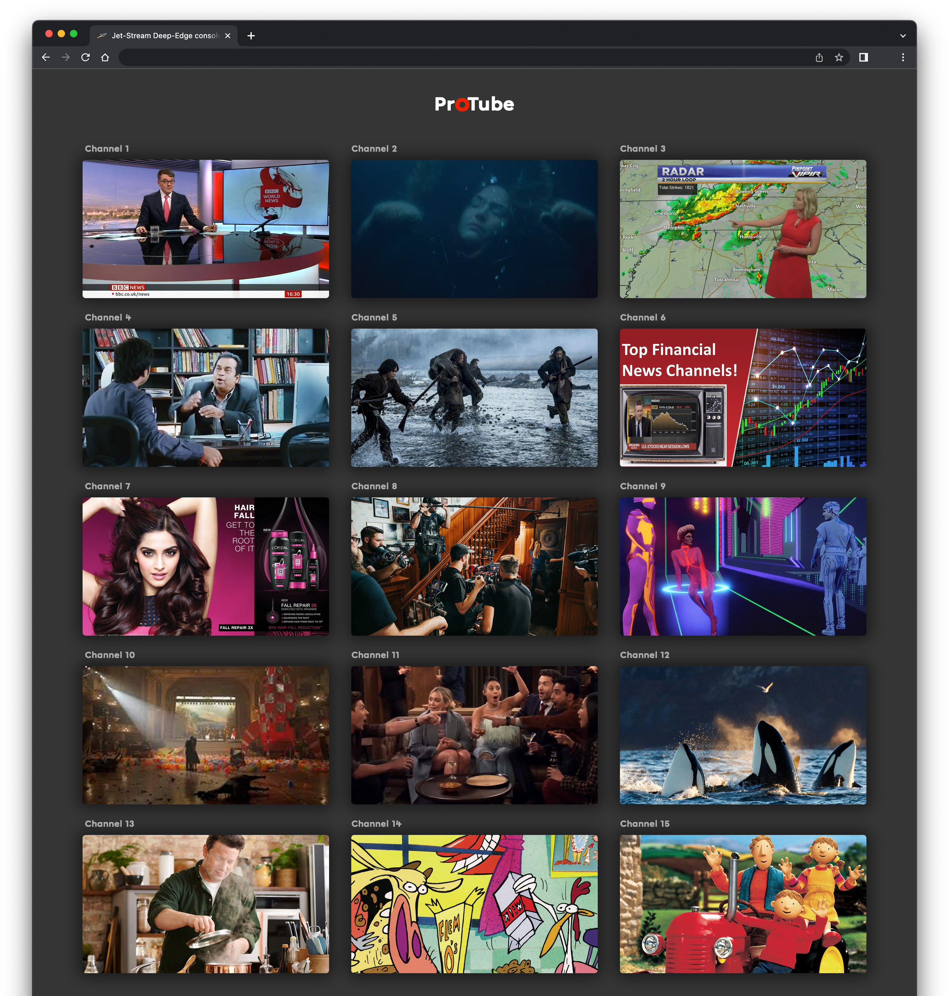
OTT Portal

Slide 38
Health and load status
Oversee performance, uptime and status of transcoding services

Slide 39
Expert.
Build your own airplane.

Slide 40
MaelStrom OTT
Turnkey OTT solution in a box

Slide 41
Jet-Stream Cloud
Encoding, Transcoding, Origins, multi-CDN, Security, Player, Statistics

Slide 42
Private Cloud
Your dedicated transcoding cloud, green, cost disruptive, easy, fully customisable.

Slide 43
On-Premises
Run your own transcoding stack

Slide 44
Licensing
Build your own transcoding stack, using your own hardware

Slide 45
Was that disruptive enough for you? :)

Slide 46
jet-stream.com
stef@jet-stream.com

